Slide 1
APUSH Review: Key Concept 3.3
Period 3: 1754 – 1800
Everything You Need To Know About Key Concept 3.3 To Succeed In APUSH
Updated for the 2015 revisions

Slide 2
The New Curriculum
Key Concept 3.3 “Migration within North America and competition over resources, boundaries, and trade intensified conflicts among peoples and nations. .”
Page 41 of the Curriculum Framework
Big ideas:
What were achievements of the Northwest Land Ordinance?
How did foreign policy debates impact America domestically?
What was the message of George Washington’s Farewell Address?

Slide 3
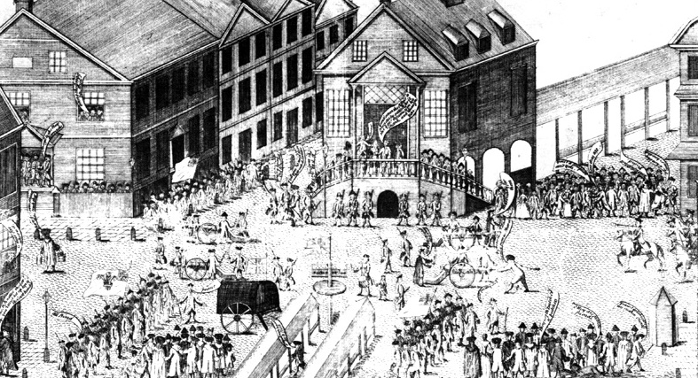
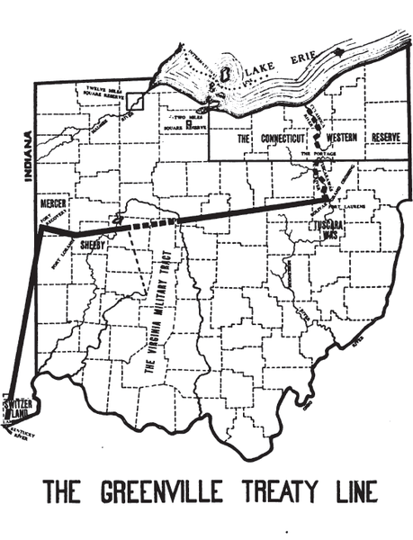
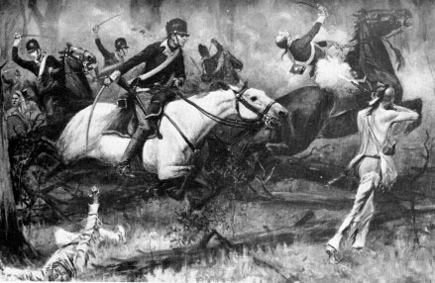
Key Concept 3.3, I
“In the decades after American independence, interactions among different groups resulted in competition for resources, shifting alliances, and cultural blending. .” - Page 41 of the Curriculum Framework
A) Relations with Natives post-Revolutionary War
Battle of Fallen Timbers (1794 - Ohio):
Native Americans, led by Little Turtle were defeated by Americans – 630 Americans were killed
In 1794, the Indians signed the Treaty of Greenville
Natives ceded a significant amount of land, were allowed to retain some land, which was later encroached upon
Britain and Natives’ relationship contributed to tensions with the US – War of 1812
B) Frontier Cultures:
Scots-Irish (Paxton Boys):
Tended to settle on the frontier (edges of settlement)
Settled on land without regard for ownership (government, natives, etc.)
Displaced and suppressed Native Americans
Shays’ Rebellion:
Rebellion of farmers that demanded an end to foreclosures, imprisonment for debt, and paper currency
Closed courts
These illustrated tensions between poor (backcountry) and wealthy (interior)

Slide 4
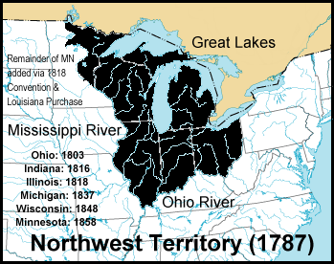
Key Concept 3.3, I
C) Northwest Land Ordinance (1787):
Created a process to admit new states (once a population of 60,000 was reached)
Guaranteed freedom of religion and trial by jury (this was before the Bill of Rights)
A portion of land sales went to fund education (16th square mile)
Slavery was abolished in the territory
Protection of private property
D) Government relations with Natives:
In the Constitution, there was NO mention of treatment/relation with Natives; did not have representation in government
This led to issues over land
Treaty of Greenville – Discussed in 3.1, A
E) Spain expanded settlements into California (1760s):
Missions, or forts were created and trade expanded
Many natives died from disease, others were forced to convert to Christianity

Slide 5
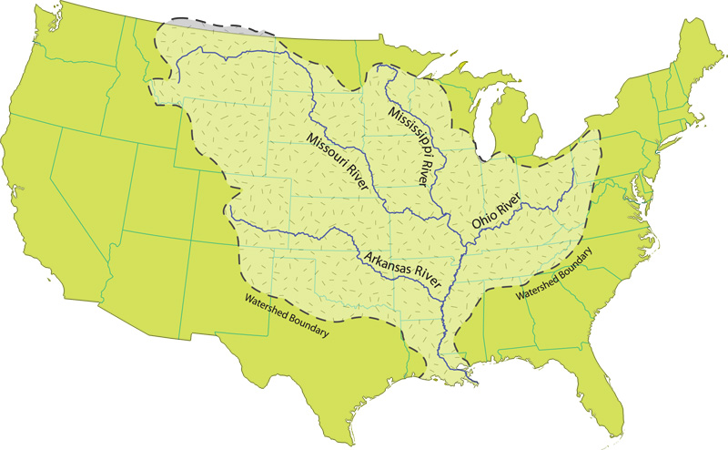
Key Concept 3.3, II
“The continued presence of European powers in North America challenged the United States to find ways to safeguard its borders, maintain neutral trading rights, and promote its economic interests.” - Page 42 of the Curriculum Framework
A) Diplomatic Initiatives:
Jays’ Treaty (1795):
Treaty with Britain
US received compensation for damaged ships (upset the South)
Britain promised to leave posts (forts)
One cause of the development of political parties
Pinckney’s Treaty (1795):
Treaty with Spain
US granted navigation rights on the Mississippi River (Right of Deposit) in New Orleans

Slide 6
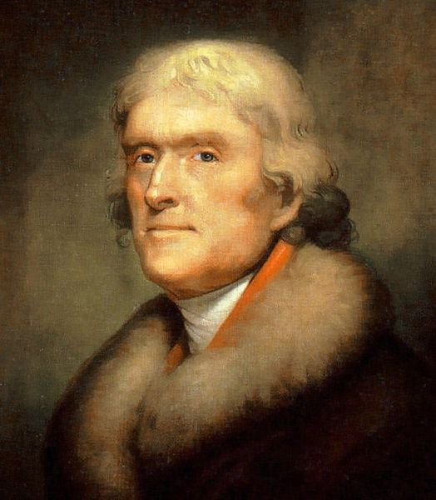
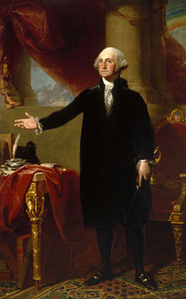
Key Concept 3.3, II
Beware of foreign alliances and political parties
Viva La France!
B) Impacts of the war between Britain and France?
Influenced by American Revolution and Enlightenment ideas
US remained neutral in conflict between France and Britain
France and Britain both sought to keep the US from trading with the other
Impressment – forced taking of soldiers into the British navy (War of 1812)
Another cause of the emergence of political parties…..
Democratic-Republicans (Jeffersonians) tended to support the French
Federalists (led by Hamilton) tended to support the British
C) Washington’s Farewell Address:
Encouraged national unity
Warned against:
Political parties
Permanent foreign alliances
Make sure you can connect this to the failed Treaty of Versailles (1919) AND the US joining NATO after WWII

Slide 7
Test Tips
Multiple-Choice and Short Answer Questions:
Washington’s Farewell Address
Northwest Land Ordinance – achievements, how could it be seen as sectional tension?
Reasons for the development of political parties
Essay Questions:
Issues that led to the creation of political parties

Slide 8
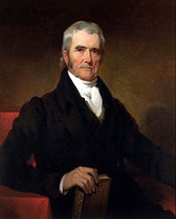
See You Back Here For Key Concept 4.1!
Thanks for watching
Please subscribe and share
Good luck in May
You’re brilliant!

